Slide 1
Bike Sharing Demand Prediction
Supervised Machine Learning
Jeetendra Sarpe

Slide 2
Index
Introduction
Project understanding
Exploratory Data Analysis
Linear Regression
Different Techniques
Final Model
Conclusion

Slide 3
Project Understanding
Currently Rental bikes are introduced in many urban cities for the enhancement of mobility comfort. It is important to make the rental bike available and accessible to the public at the right time as it lessens the waiting time.
The crucial part is the prediction of the bike count required at each hour for the stable supply of the Rental bikes.

Slide 4
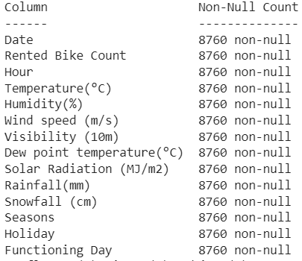
Data Understanding
Dataset consist of different features along with the target variable which is Rented Bike Count.

Slide 5
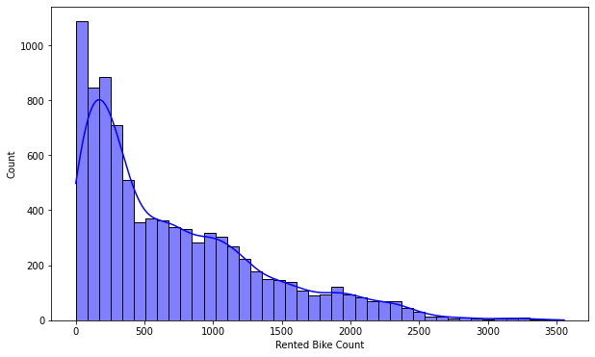
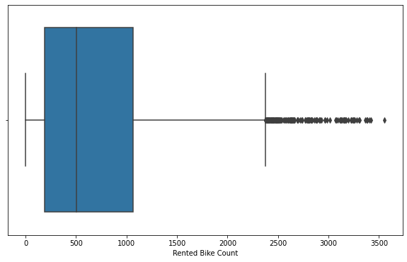
Exploratory Data Analysis

Slide 6
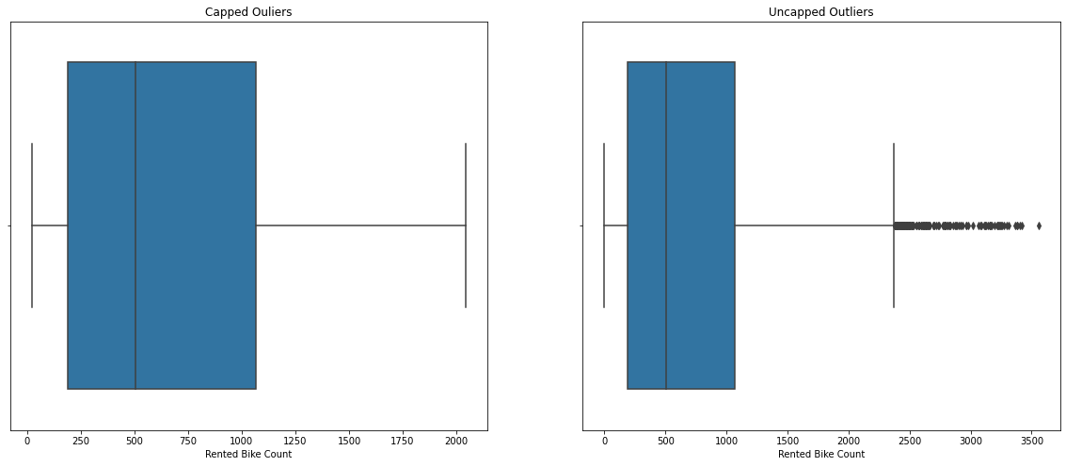

Slide 7
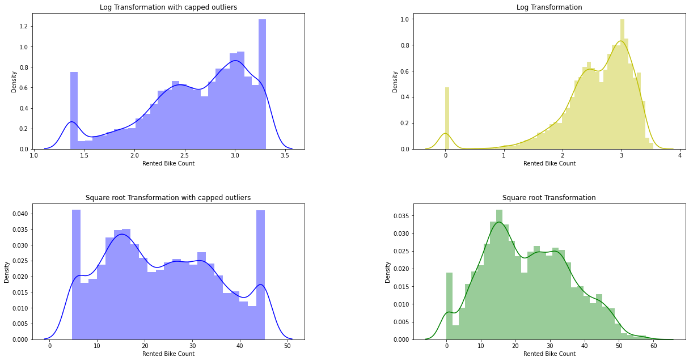

Slide 8
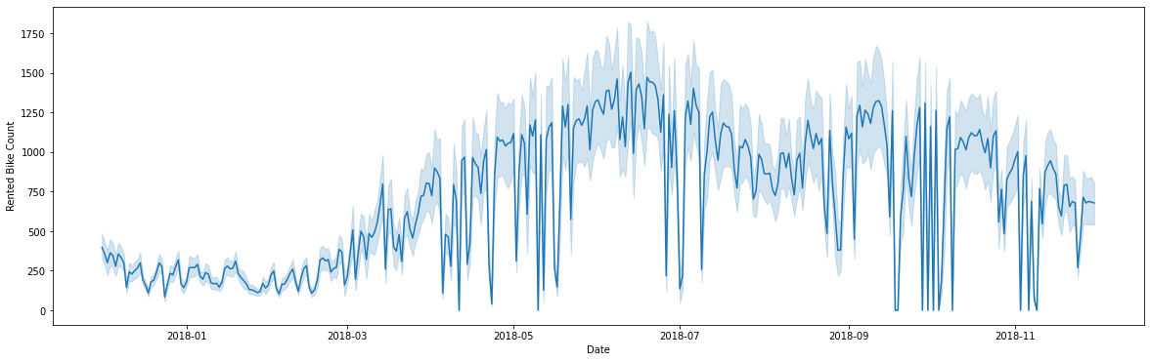

Slide 9
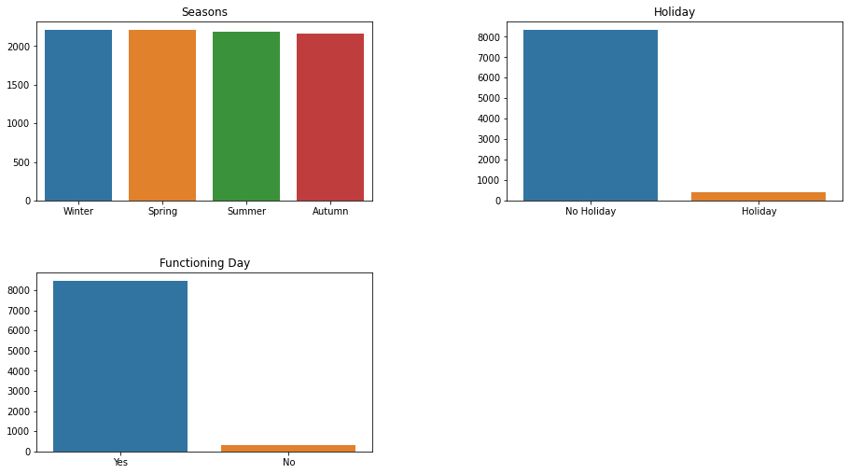

Slide 10
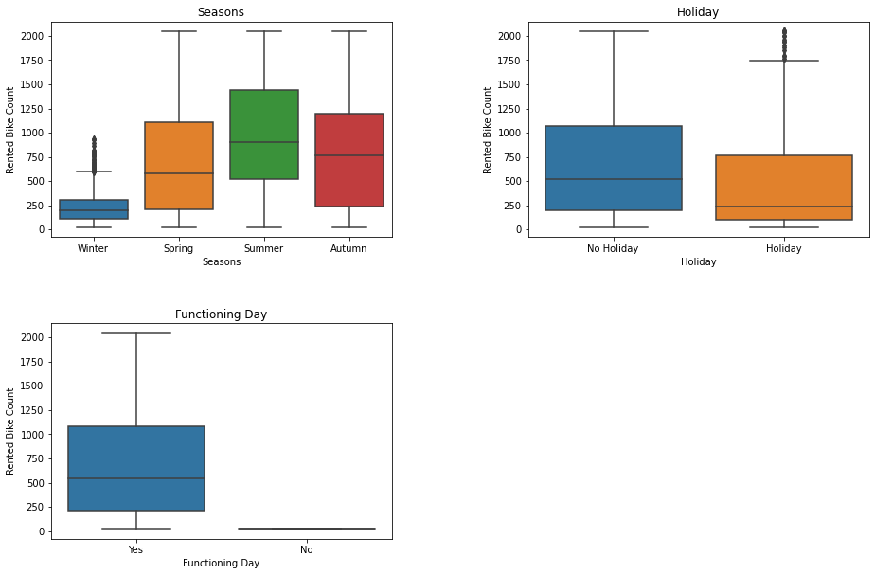

Slide 11
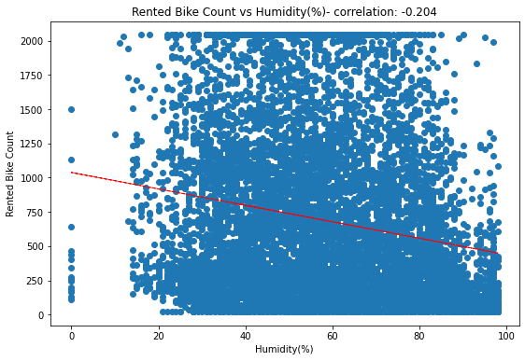
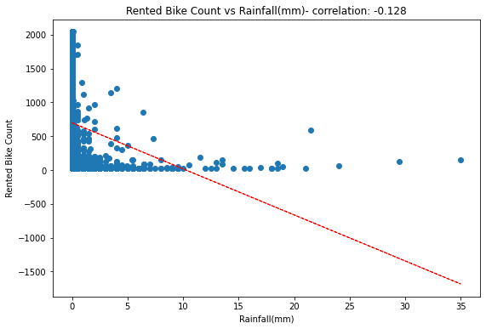

Slide 12
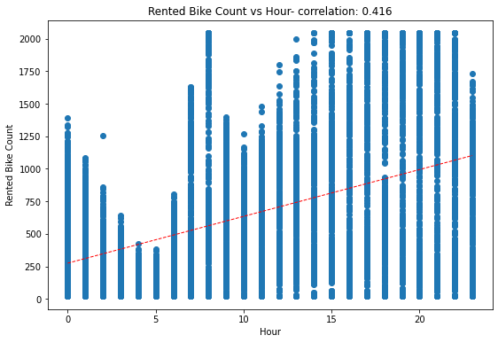
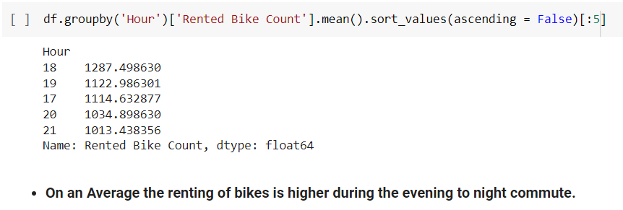

Slide 13
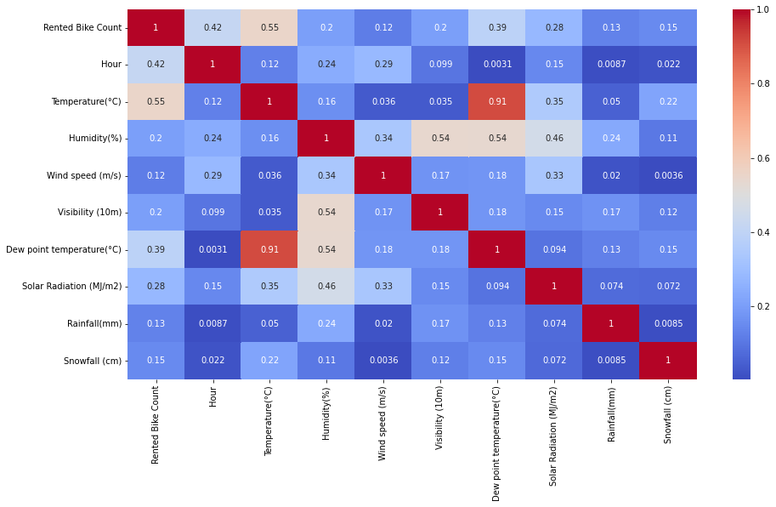

Slide 14
Observations/Hypothesis
Commuting hours or time of Renting the Bike is an important factor.
If it is a Holiday or a non functioning day Renting is less likely to happen.
For a rainy weather the impact on the renting is highly negative.
Seasons affects the renting differently, in Winter’s we see lesser numbers whereas during Autumn and Summer are attracts crowd for renting the bikes.

Slide 15
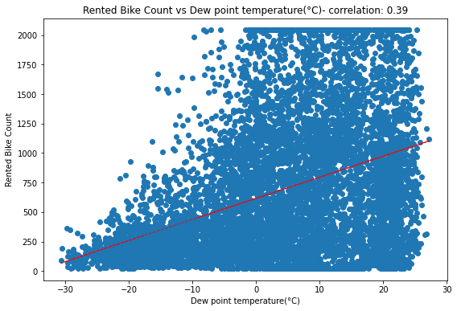
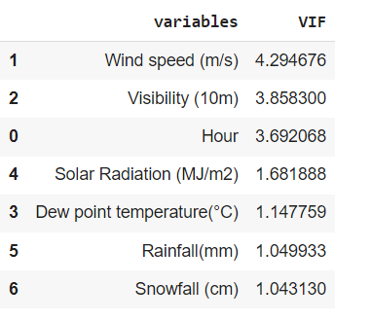
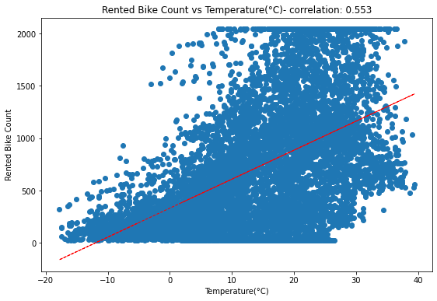

Slide 16
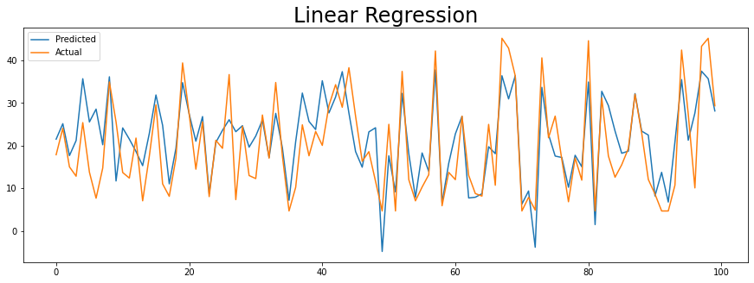
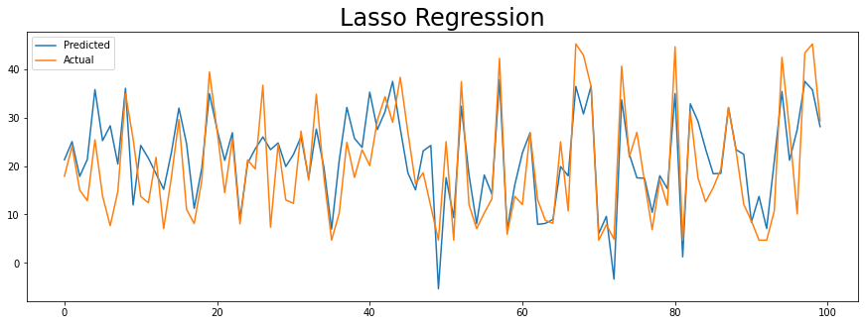

Slide 17
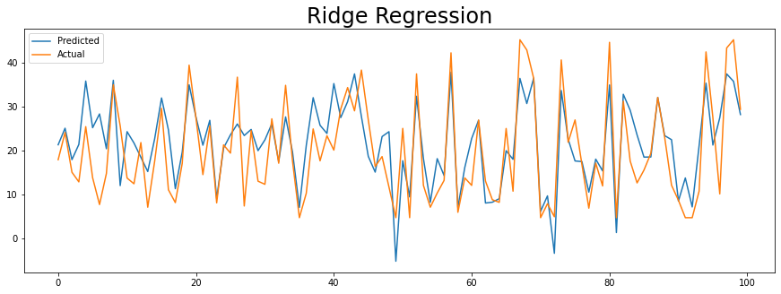
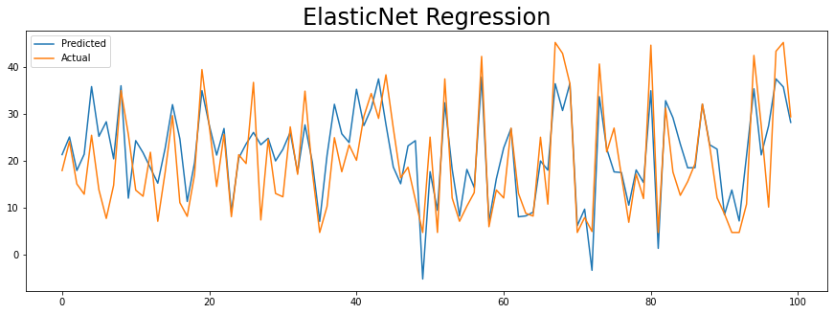

Slide 18
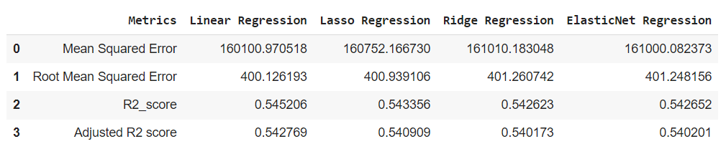
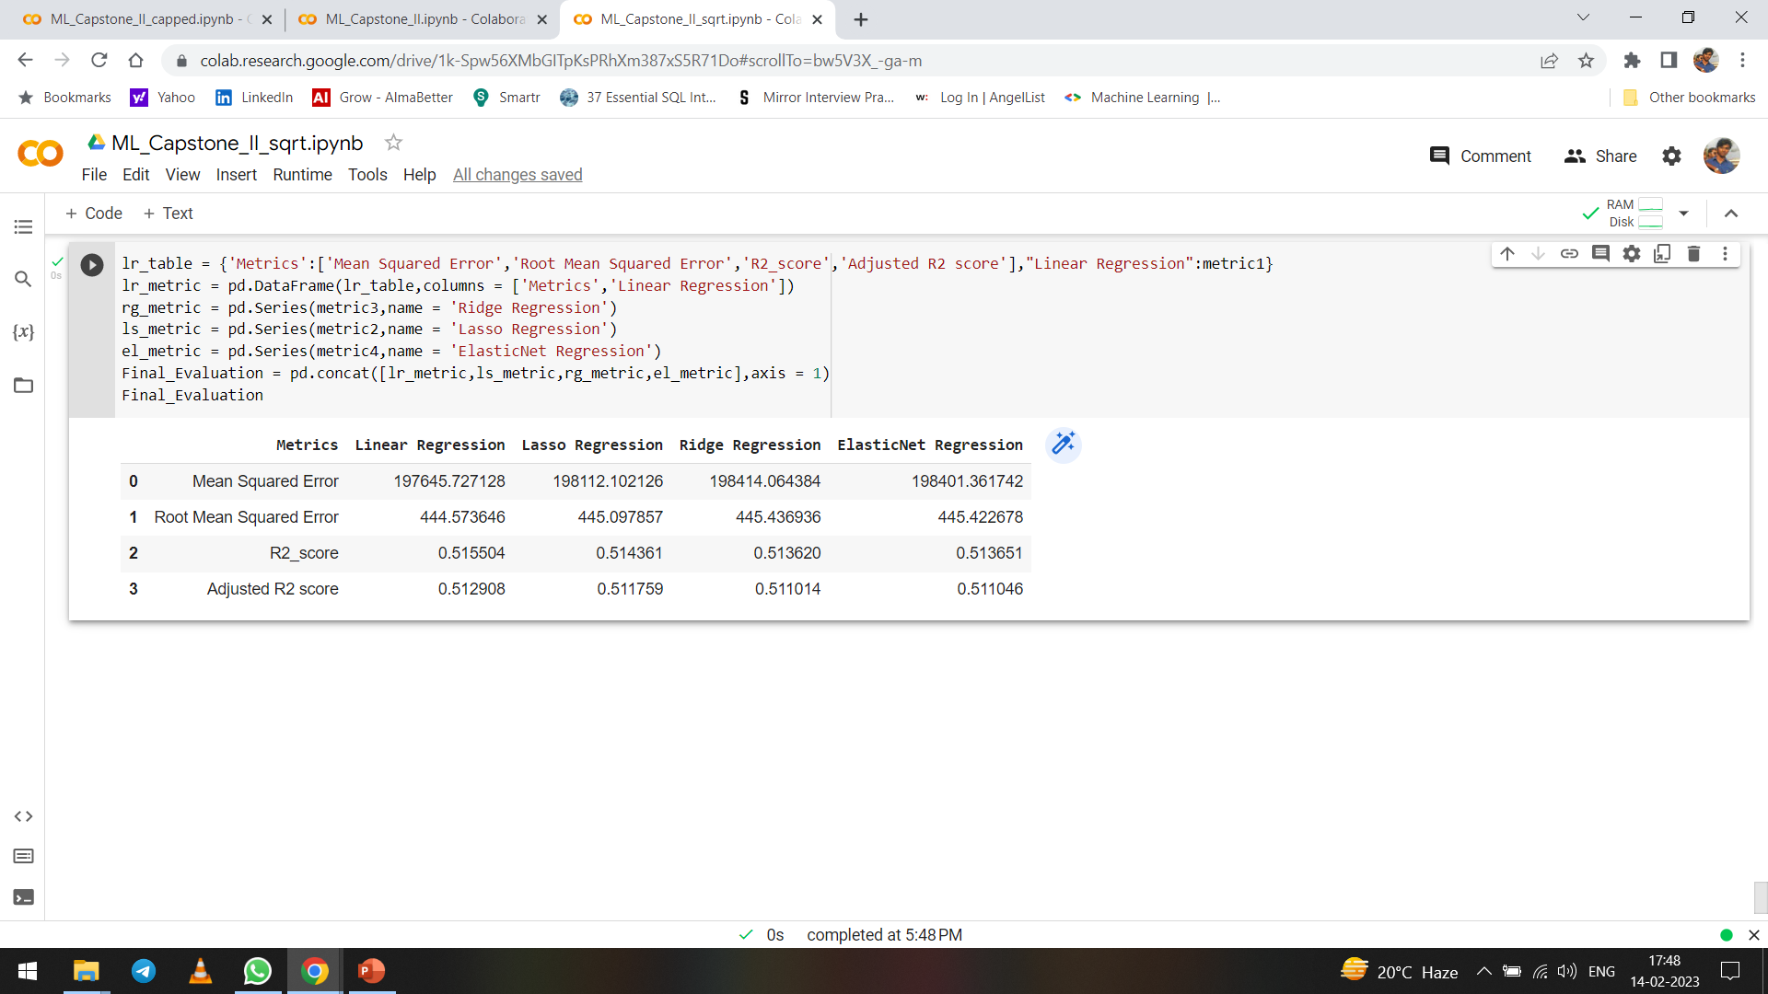
Square Root Transformation with capped outliers
Square Root Transformation with uncapped outliers

Slide 19
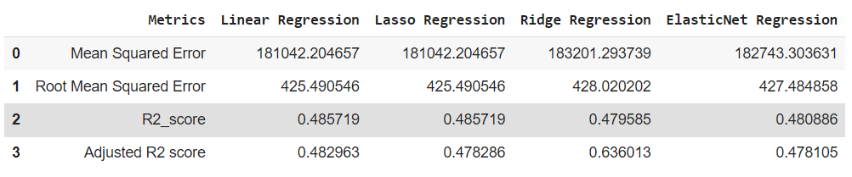
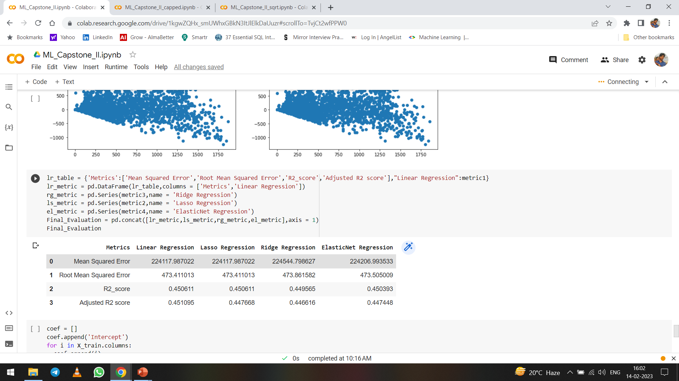
Log Transformation with capped Outliers
Log Transformation with uncapped Outliers

Slide 20
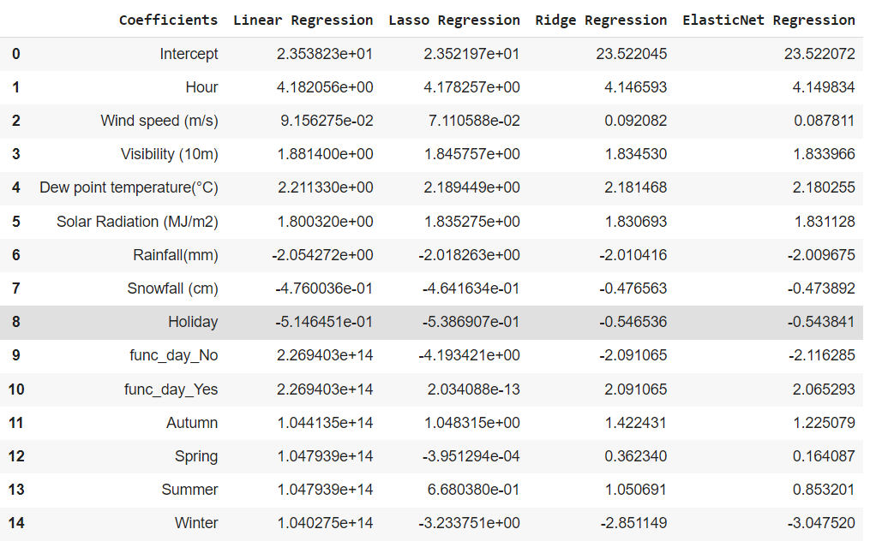

Slide 21
Rented Bike count =
23.521 + 4.17Hour + 0.0711Wind Speed + 1.845Visibility + 2.189Dew Point Temperature + 1.835Solar Radiation - 2.18Rainfall - 0.464Snowfall - 0.538Holiday - 4.19func_day_No + 2.03e^-13func_day_Yes + 1.04Autumn -3.95e^-4Spring + 0.686Summer - 3.233Winter
To put in simple words Bike renting is strongly influenced by the Hour of the followed by the Dew point temperature, Visibility and Solar radiation.
If it is not a Functioning day or if there is a Rainfall the Renting of bike decreases significantly.
Autumn is a favorable season for riding and renting a bike and the count dips down if it is a Winter day.
Rest other feature contributes in a smaller portion in the Renting of the Bike.

Slide 22
Enjoy Riding….

